Slide 1
Recruitment: Character, Honor, Integrity
Alpha Chi Rho National Fraternity

Slide 2
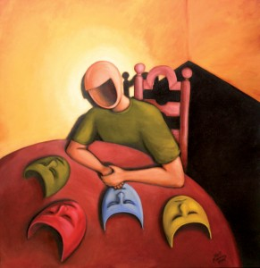
Why Does Our Chapter Struggle?
-Identity Crisis
-Participation
-Organization

Slide 3
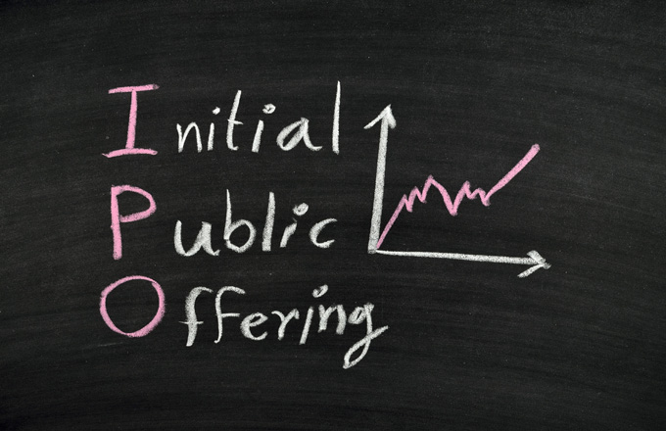
Why Does Our Chapter Struggle?
-I.P.O. initial offering of Chapter to Public
-We want Public to invest in us
-Strong Offering = Strong Recruitment

Slide 4
Identity Crisis
Let’s get real!
Who are we?
What is our reputation?
What is our desired reputation?
How do we get there?

Slide 5
Participation
https://www.youtube.com/v/KtMPMkF_VfU&autoplay=1

Slide 6
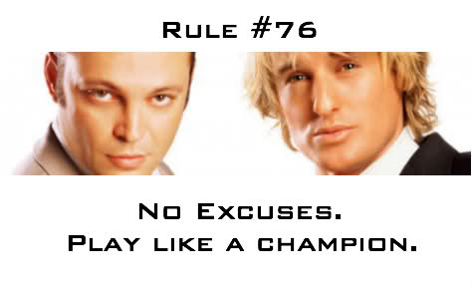
Participation
-NO EXCUSES!
-Vital to Chapter survival
-Responsibility to replace yourself each semester
-Highest priority of Chapter

Slide 7
Participation
-Push Yourself, Set Goals
-Rush Week Goals
-Semester Goals
-How will you get there?

Slide 8
Participation
-Developing Chapter of Extroverts
-Stair Conversations, Asking the RIGHT question!
-Confidence building exercises
-Supporting each other

Slide 9
Organization
-First impressions are most important
-Must send consistent and clear message
-Must present consistent and clear image

Slide 10
Organization
Rush Week/Recruitment
-Responsibilities must be delegated
-Advertising through social media and other mediums far in advance
-Registering of events and space well in advance

Slide 11
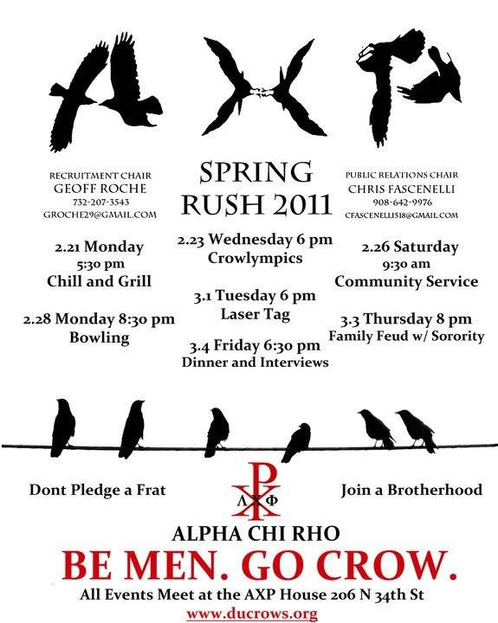

Slide 12
Continued Recruitment
Quick Tips
-Focus energy on face-to-face meetings and less on events
-Alcohol is prohibited at recruitment events
-Recruitment should be ongoing throughout the entire semester

Slide 13
Continued Recruitment
-It is each Brother’s responsibility to replace himself during recruitment each semester
-Each member should be involved in at least one other club to help the Chapter gain exposure
-Your job is to LISTEN, be sure that you are asking the right questions

Slide 14
Let’s Get Our Guys!
Assembling Recruitment List
-Bring the name of one new person to Chapter each week
-Reach out to other organizations for a list of recommendations of recruitable men.

Slide 15
Let’s Get Our Guys!
-Tabling, posting flyers, and addressing lecture halls are all great tools in gaining visibility on campus.
-The recruitment list should have 350 – 650+ recruitable men on it, with 90% of the list being accurate contact information.

Slide 16
Let’s Get Our Guys!
Face-to-Face Recruitment
-Call each potential once per day
-Should have at least 7 contact points with individual
-Make time to meet each potential in person

Slide 17
Let’s Get Our Guys!
Asking the RIGHT questions!
-Why are you interested in joining Greek Life?
-What is unique about you that you would bring to our Chapter?
-Why are you interested in Alpha Chi Rho?

Slide 18
Asking the RIGHT questions!
-What are you looking to get out of this experience?
-Is there anything that I can do to address any of your concerns and see to it that you achieve all of your goals?
-What are some of your short term/long term goals?

Slide 19
Let’s Get Our Guys!
Traditional Recruitment
-Organization and delegation is key
-Advertisement vital to success
-Events should reflect Chapter identity!

