Slide 1
Go Brand Yourself! The do’s and don’t of fraternal social media

Slide 2
How do we brand ourselves as an organization?
The way we act.
The way we appear.
The way other people perceive us.
Our interactions with other organizations.
How we look in the virtual world.

Slide 3
Personal experience
The way we act
Around students
Around administrators
Around other organizations
Your actions reflect your Chapter and the National Organization
The way we appear
How we dress
The perception
Not just physically
Be positive and positive will attract

Slide 4
Perception
How do we get others to perceive us positively?
Values, Values, Values
Our interactions count.
Be visible!
Positive awareness.

Slide 5
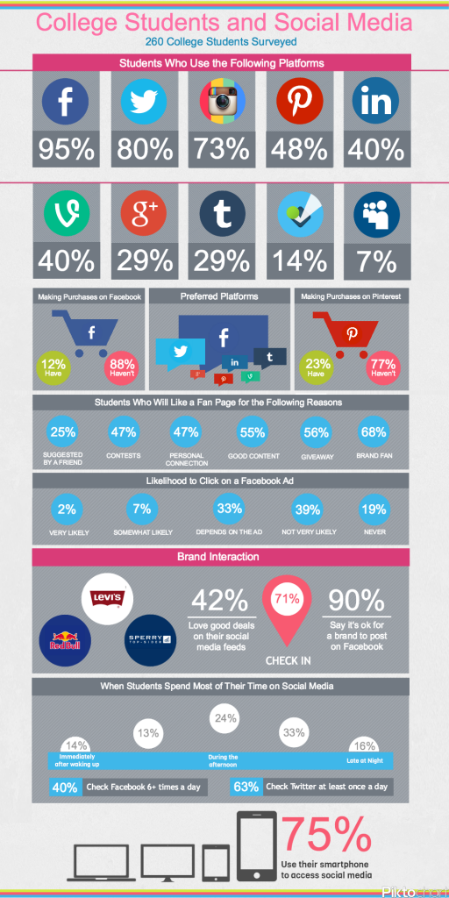
We all use it but who’s watching?
Percentage of students who use the following social media platforms
Facebook- 95%
Twitter- 80%
Instagram- 73%
Pintrest- 48%
Linkedin- 40%
Vine- 40%
Google +- 29%
Tumblr- 29%
And no one uses Myspace..

Slide 6
Good Perception
How do we utilize these free tools?
Positive awareness
Professionalism
Service
Philanthropy
Brotherhood
COMMON SENSE

Slide 7
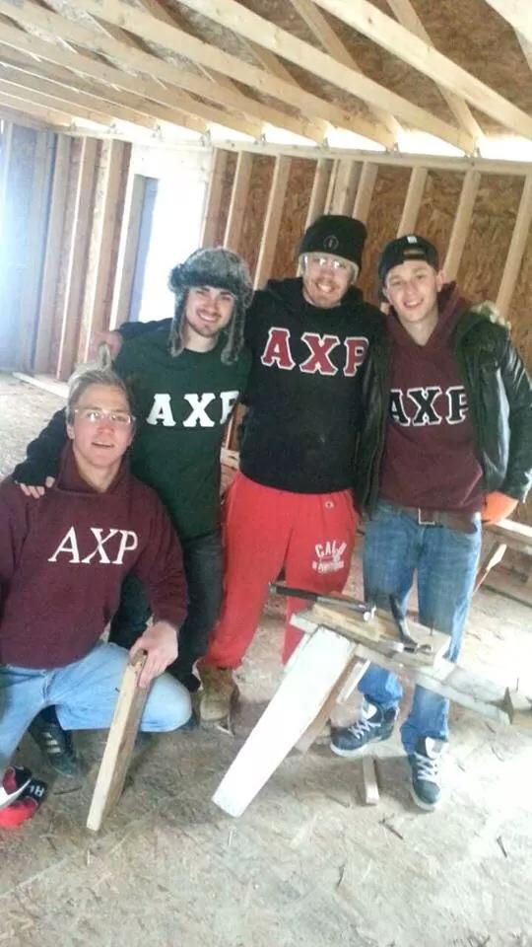
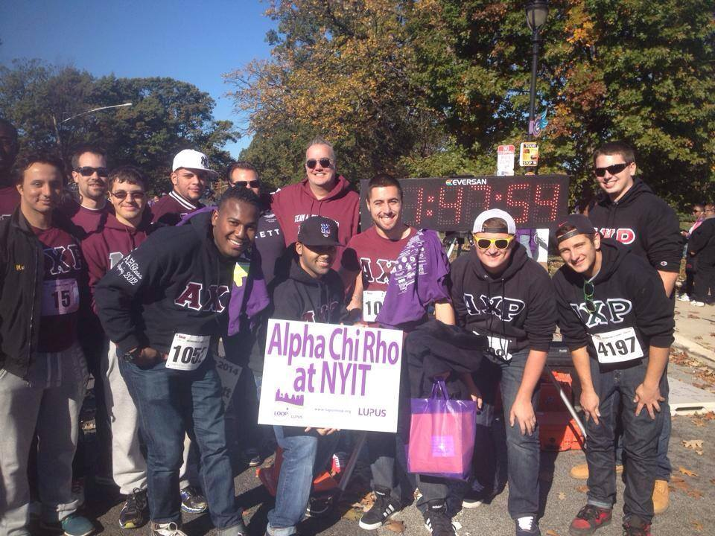
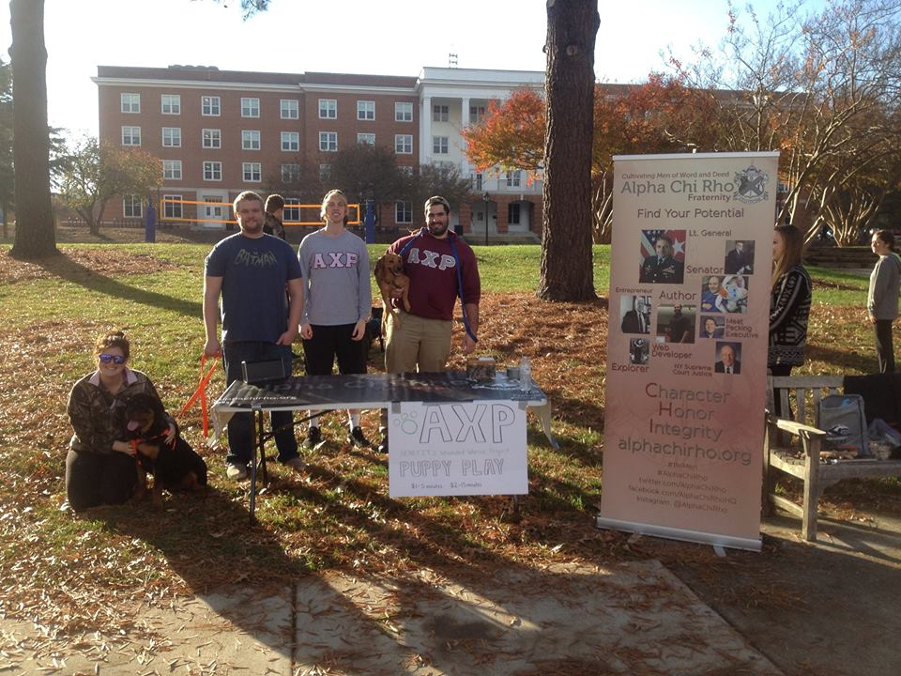

Slide 8
#BeMenMondays
Highlight what it means to “Be Men”
Universal concept
Helps with your Chapter and with National
Connect with other Chapters through social media networking
Trend it on your campus

Slide 9
The Result
People’s perception will change
Better recruitment
Better members
Better The Organization

Slide 10
Negative Perception
Negative perception
Negative publicity
Attracting the wrong members
Infects the Chapter like a disease
Negativity becomes a trend

Slide 11
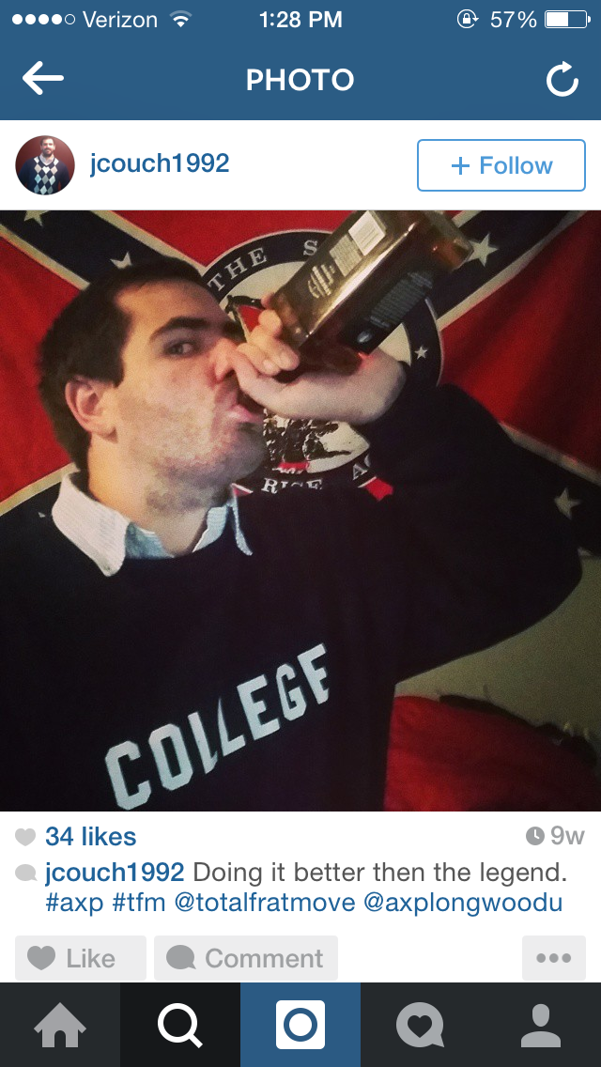
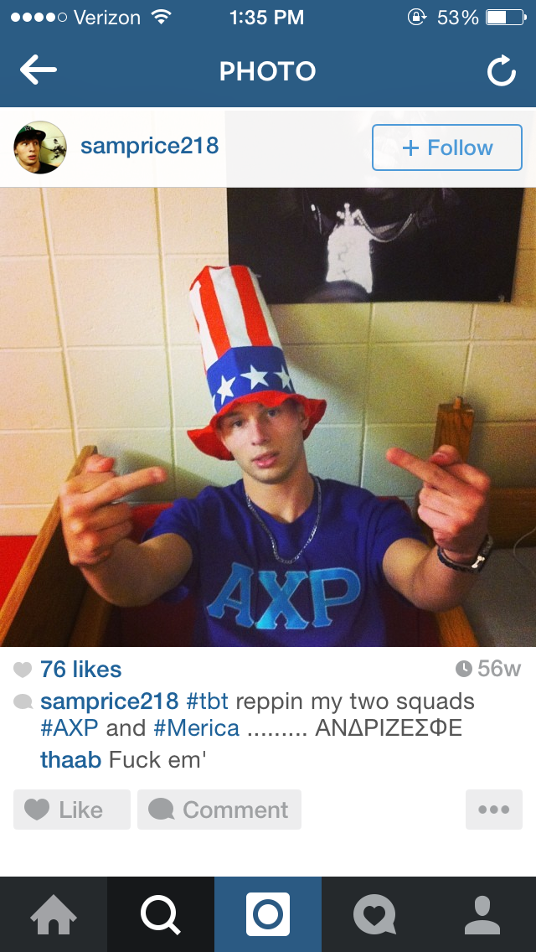
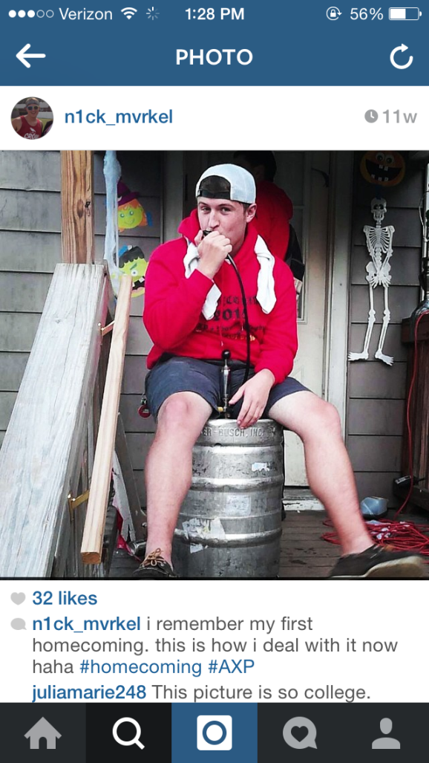
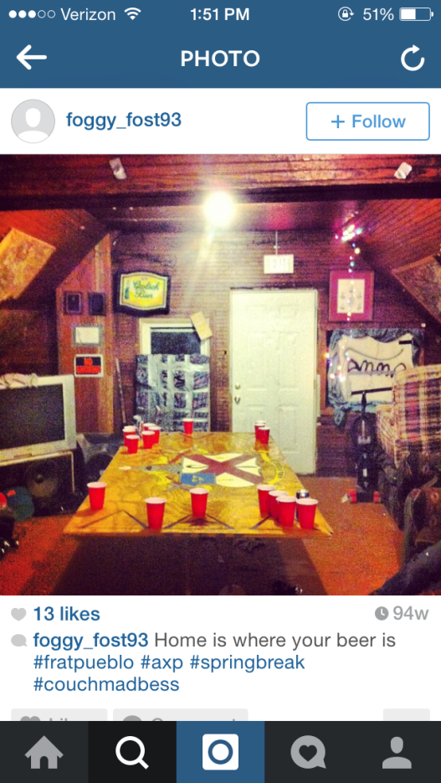

Slide 12
You have the tools but use them the right way!
Professionalism, personally and through media
+
Positive Awareness and Positive Publicity
=
Steps towards a better Chapter

