Slide 1
Mental Health Initiative
Alpha Chi Rho National Fraternity

Slide 2
Understanding Mental Health
What is Mental Health?
Emotional, Psychological, and Physical Well-Being
Affects how we think, feel, and act
Determines how we handle stress, relate to others, and make choices

Slide 3
Understanding Mental Health
Mental Health is directly related to Physical Health
Has remained taboo in society, never talked about
Giving the tools to address Mental Health, but not just the negative side

Slide 4
Promoting Mental Health
Balanced Lifestyle is Key
Exercise
Emotions
Sleep

Slide 5
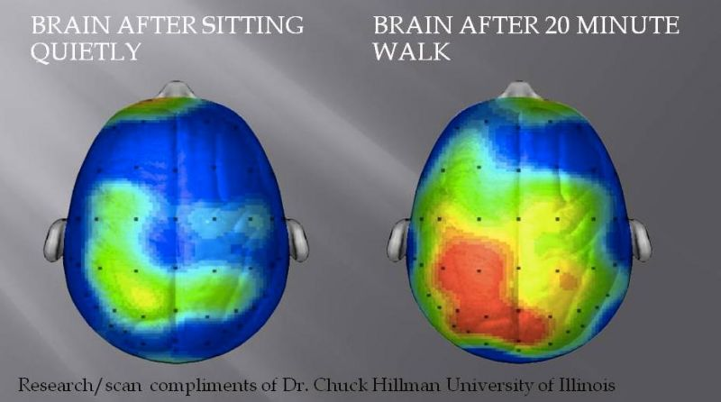
Promoting Mental Health
Exercise
Gain confidence
Take mind off worries
Get more social interaction
Cope in a healthy way

Slide 6
Promoting Mental Health
Emotions
Pay attention to your moods
What is causing emotions?
How do you get emotions in order?
How am I coping with emotions?

Slide 7
Promoting Mental Health
Sleep
Most important to maintaining healthy mind
Sleep deprivation is favored form of torture
3 to 5 hours of sleep can break a person
Most college students average 3 to 5 hours of sleep

Slide 8
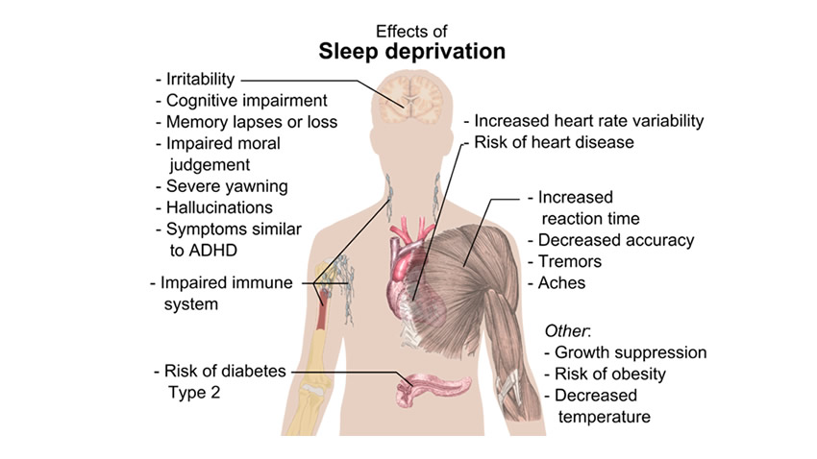
Promoting Mental Health

Slide 9
Promoting Mental Health
Chapter exercises promoting health
Notecard Exercise
Mental Health Worksheet
Don’t be afraid to ask for help
Cope in healthy ways!

Slide 10
Crisis Mode
Warning sings
Changes in behavior
Threatening to hurt themselves

Slide 11
Crisis Mode
What to do if there is an issue in your Chapter
Stay vigilant of Brothers, be each other’s keepers
Don’t be afraid to ask how they are doing
When concerned, isolate individual with Brothers to keep watch and “talk him off the ledge”
President’s room is usually a good place to isolate member

Slide 12
Crisis Mode
What to do if there is an issue in your Chapter
Remove harmful objects
Keep conversation light
Someone must contact campus Mental Health Professional immediately
Contact Police if need be

Slide 13
Contacting On-Campus Mental Health Professional
Resource readily available 24/7 at each school
Google Search (School + Campus + Mental Health Professional)
Numerous resources will appear
Choose the resource that suits your needs best
Don’t be afraid to involve police if situation is out of control

